Slide 1
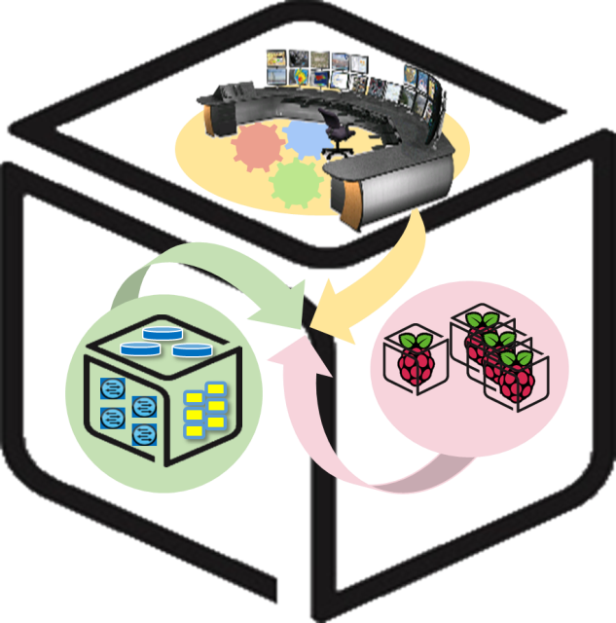



Computer Systems
For AI-inspired Cloud
Theory & Lab.
Lab #1: Box
https://github.com/SmartX-Labs/SmartX-Mini-MOOC

Slide 2






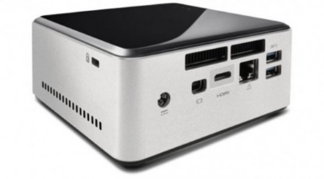
Box Lab: Outline
VM
Container
Tap1
ping test
br0
eth0

Slide 3


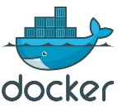

Box Lab: Final Goal
VM

Slide 4

Before you start
- Things you need to know
Lab Theory
Lab
Practice
Lectures are divided into Lab Theory, Lab Practice and Lab Review parts.
Lab
Review
The keyboard means that you should execute instructions by following the guidance.

Slide 5



Lab Theory

Slide 6

Linux Box with Virtualization/Containers
VM
Container
Tap1
ping test
Virtual Machine
&
Container
br0
eth0
Linux Box

Slide 7
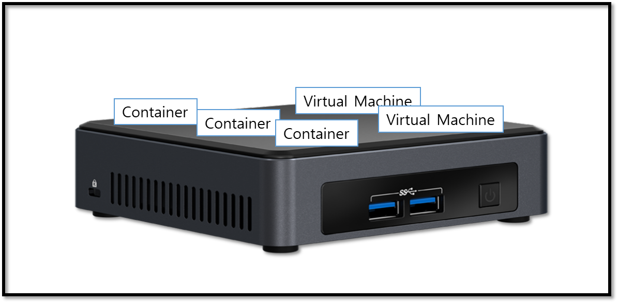
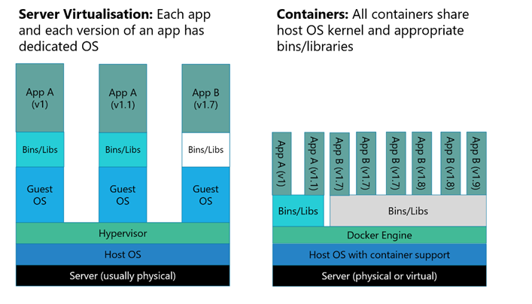

VMs and Containers on a Linux Box
On a Linux Box (e.g., NUC)
Multiple fully-isolated (with dedicated resources), but heavy VM instances (i.e., VMs).
Multiple partially-isolated, lightweight container instances (i.e., containers)
Virtual Machines (VMs)
Containers
Heavier than
Container!
Hypervisor Tool for creating VMs
Container Runtime Tool for running containers

Slide 8

A Switch inside Linux Box: Open vSwitch
VM
Container
Tap1
ping test
br0
eth0

Slide 9
Virtual Switch in a Box to connect VMs
Hypervisor
VM
VM
VM
VM
Linux Box
Virtual NIC
Virtual interface
Virtual switch
Virtual L2 network
Physical switch
L2 network
A software-based virtual switch allows one VM to communicate with neighbor VMs as well as to connect to Internet (via physical switch).
Software-based switches (running with the power of CPUs) are known to be more flexible/upgradable and benefited of virtualization (memory overcommit, page sharing, …)
VMs (similarly containers) have logical (virtual) NIC with virtual Ethernet ports so that they can be plugged into the virtual interface (port) of virtual switches.

Slide 10

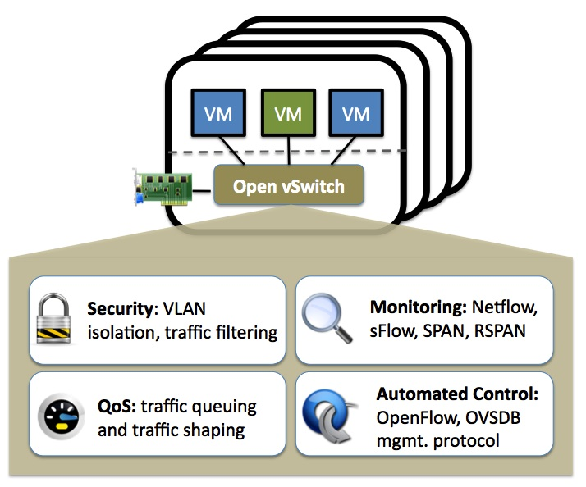
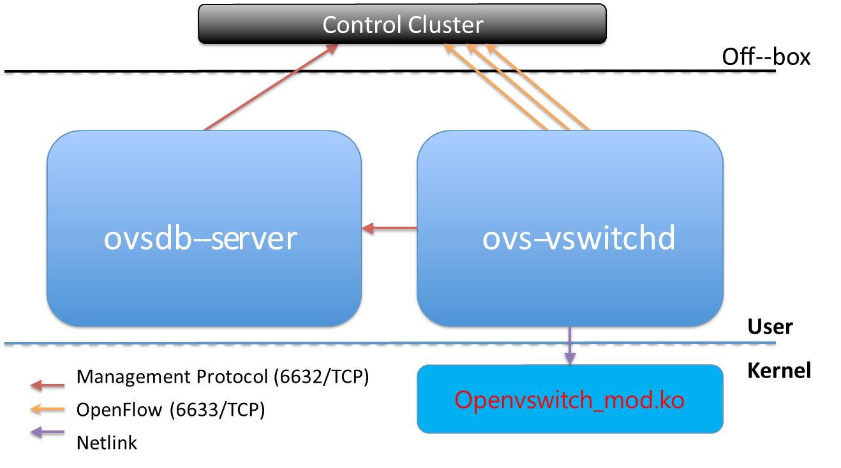
Linux-adopted virtual switch: Open vSwitch
http://openvswitch.org/
Open vSwitch is an open-source virtual switch software designed for virtual servers.
OVS Main components

Slide 11
Lab Practice

Slide 12
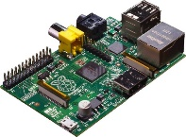
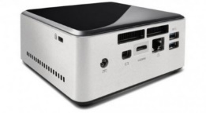


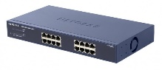
NAME: NUC5i5MYHE (NUC PC) CPU: i5-5300U @2.30GHz CORE: 4 Memory: 16GB DDR3 HDD: 94GB
#0 - Lab Preparation
Wired connection
NAME: Raspberry Pi Model B (Pi) CPU: ARM Cortex A7 @900MHz CORE: 4 Memory: 1GB SD Card: 32GB
NAME: NT900X3A
CPU: i5-2537U @1.40GHz
CORE: 2 Memory: 4GB DDR3 HDD: 128GB
NAME: netgear prosafe 16 port gigabit switch(Switch) Network Ports: 16 auto-sensing 10/100/1000 Mbps Ethernet ports

Slide 13

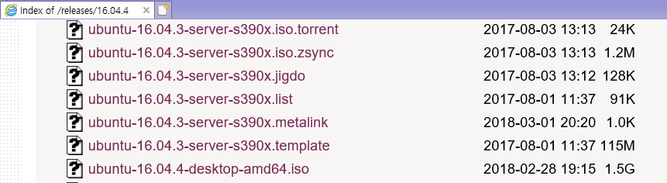
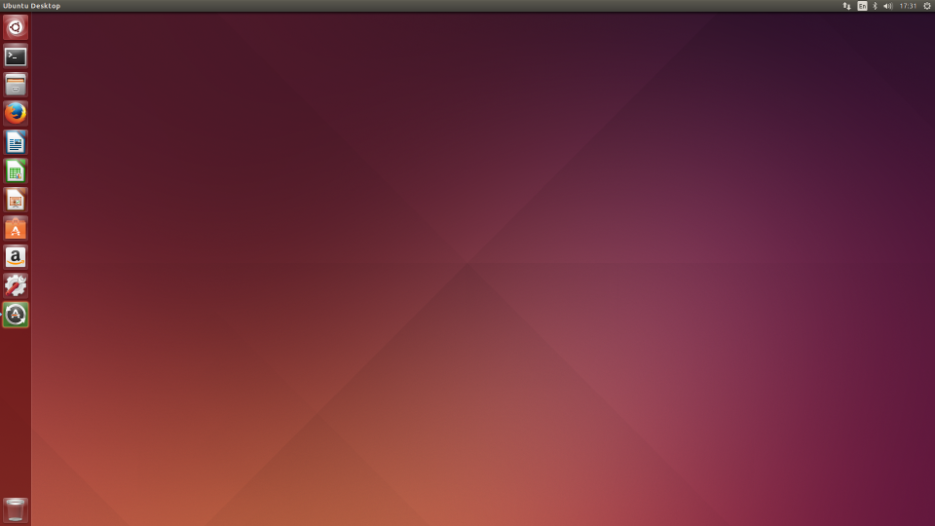
#1 - NUC: OS Installation
OS : Ubuntu Desktop 16.04.4 LTS(64bit)
Download Site : http://old-releases.ubuntu.com/releases/16.04.4/
Bootable USB configuration (no bootable CD, no CD-Rom in NUC) using the downloaded file (ubuntu-16.04.4-desktop-amd64.iso, 1.5Gb)
Installed on NUC
Ubuntu Home Screen After Installation

Slide 14
#2 - NUC: Network Configuration (1/4)
VM
Container
Tap1
ping test
br0
eth0

Slide 15
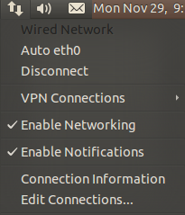
#2 - NUC: Network Configuration (1/4)
- eth0 interface
Do not check ‘Enable Networking’
$sudo vi /etc/network/interfaces
----------------- /etc/network/interfaces -----------------
auto lo
iface lo inet loopback
auto eth0
iface eth0 inet static
address [ip address]
netmask [subnet mask]
gateway [gateway]
dns-nameservers [nameserver 1] [nameserver 2]
----------------------------------------------------------------------------
$sudo ifdown eth0
$sudo ifup eth0
Your Box
NUC internet works!
eth0
203.237.x.x

Slide 16
#3 - NUC: OVS installation
VM
Container
Tap1
ping test
br0
eth0

Slide 17
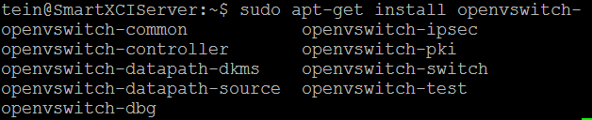
#3 - NUC: OVS installation
- Update installation of OVS package
Update index information of Open vSwitch package.
Install a Open vSwitch package, openvswitch-switch.
Other dependencies are automatically installed.
$sudo apt-get update
$sudo apt-get install openvswitch-switch

Slide 18
#4 - NUC: Network Configuration (2/4)
VM
Container
Tap1
ping test
br0
eth0

Slide 19
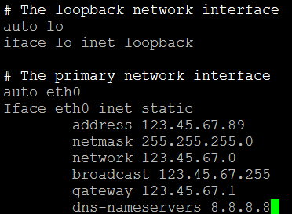
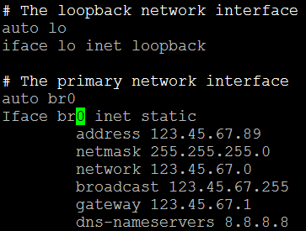
#4 - NUC: Network Configuration (2/4)
- Register OVS br0 in NUC
Modify network interface configuration.
$sudo vi /etc/network/interfaces
----------------- /etc/network/interfaces -----------------
# The primary network interface
auto eth0 # Append this line
iface eth0 inet manual # Append this line
auto (eth0->)br0
iface (eth0->)br0 inet static
…
before
After
Some NUC have different Interface name.
So you need to check your NUC’s interface name using
‘ifconfig’ command.
Don’t reboot or issue “ifup” or “ifdown” command
until the bridge operation is completed.

Slide 20
#5 - NUC: Network Configuration (3/4)
VM
Container
Tap1
ping test
br0
eth0

Slide 21
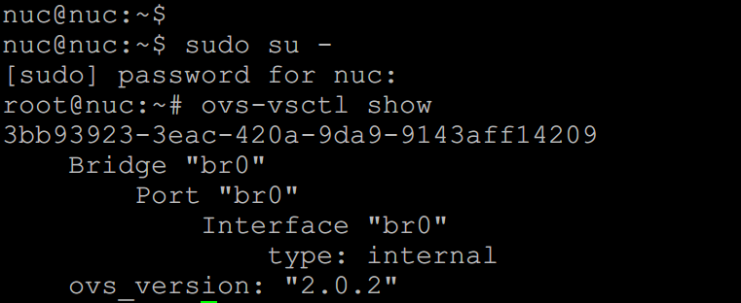
#5 - NUC: Network Configuration (3/4)
- Connect OVS br0 and NUC eth0 via OVS
$sudo OVS-vsctl add-br br0

Slide 22
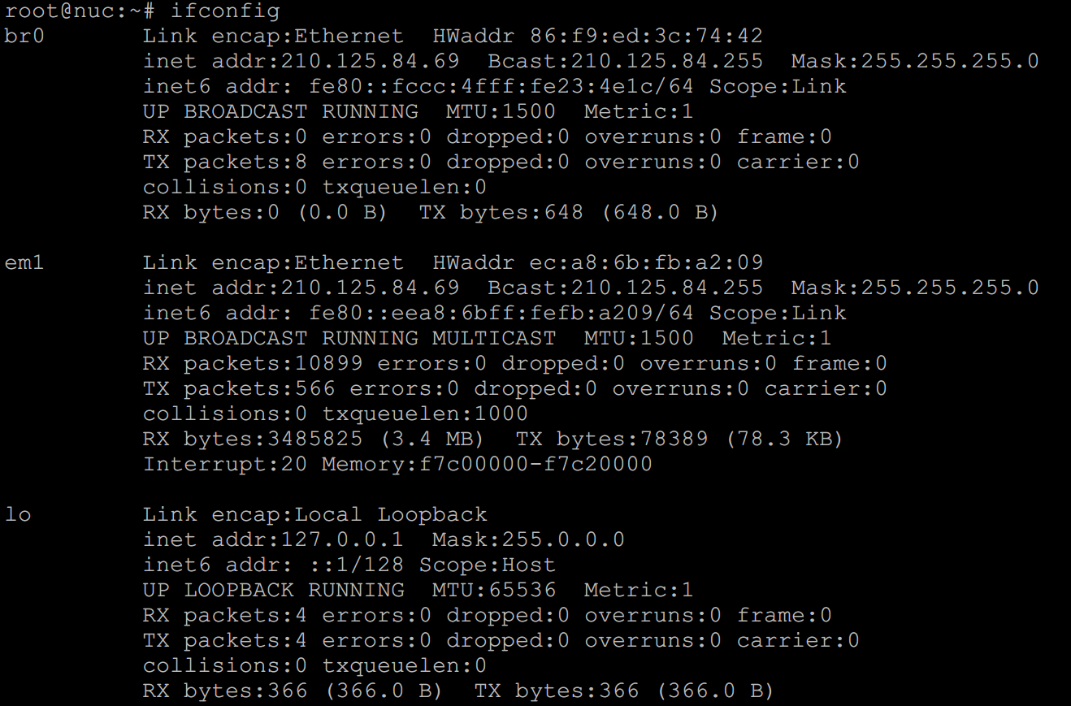
#5 - NUC: Network Configuration (3/4)
- Connect OVS br0 and NUC eth0 via OVS
$sudo OVS-vsctl add-port br0 eth0
eth0 인터페이스가 global 영역에서 bridge 영역으로 이동하기 때문에 연결이 끊김

Slide 23
#5 - NUC: Network Configuration (3/4)
- Connect OVS br0 and NUC eth0 via OVS
$sudo ip route flush table main // Removing routing table of OS
$sudo ip addr flush dev eth0 // Removing the IP address of eth0
$sudo ip addr flush dev br0 // Removing the IP address of br0
$sudo ifup br0 // Turning on “br0” interface
$sudo ip link set eth0 up // Turning on “eth0” interface

Slide 24
#5 - NUC: Network Configuration (3/4)
- Connect OVS br0 and NUC eth0 via OVS
Your Box
Your Box
br0
203.237.x.x
eth0
203.237.x.x
eth0
Your Box
VM 203.237.x.x
Note: After OVS setting, later we will create VM and connect it.
br0
203.237.x.x
eth0

Slide 25
KVM-based VM connected via OVS
- Goal of this section
VM

Slide 26
#6 - NUC: Network Configuration (4/4)
VM
Container
[Tap_name]
vport_vFunction
Tap0
ping test
br0
eth0

Slide 27
#6 - NUC: Network Configuration (4/4)
- Connect OVS tap0 & br0 through OVS
Let’s make a tap interface and attach it to your VM.
$sudo vi /etc/network/interfaces
----------------- /etc/network/interfaces -----------------
…
(Append the lines below to the config file)
auto vport_vFunction
iface vport_vFunction inet manual
pre-up ip tuntap add vport_vFunction mode tap
up ip link set dev vport_vFunction up
post-down ip link del dev vport_vFunction

Slide 28
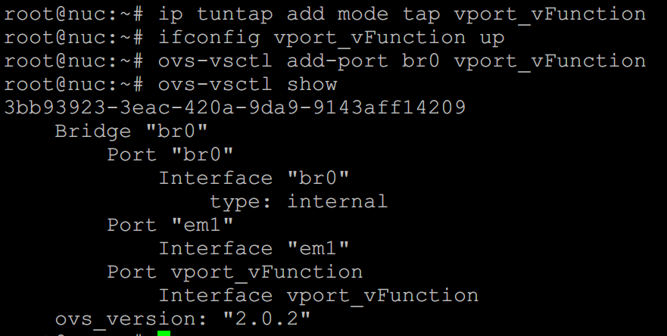
#6 - NUC: Network Configuration (4/4)
-Connect vport_vFunction, br0 through OVS
Turn on the tap interface and attach it to br0.
$sudo ifup vport_vFunction
$sudo OVS-vsctl add-port br0 vport_vFunction // Turn on and attach to br0
We should make VM attaching vport_vFunction. You can think this tap as a NIC of VM.
Your Box
VM
203.237.x.x
vport_vFunction
br0
203.237.x.x
[tap_name]
eth0

Slide 29
#7 - NUC: Making VM with KVM
VM
Container
[Tap_name]
vport_vFunction
Tap0
ping test
br0
eth0

Slide 30
#7 - NUC: Making VM with KVM
-Install dependency to upgrade KVM
Install dependency & download Ubuntu 16.04.4 64bit server image.
$sudo apt-get install qemu-kvm libvirt-bin //upgrade KVM //qemu is open-source emulator
$wget http://old-releases.ubuntu.com/releases/16.04.4/ubuntu-16.04.4-server-amd64.iso
Now we are ready to make VM. So continue the setting.

Slide 31
#7 - NUC: Making VM with KVM
-Prepare for Ubuntu VM
Make a VM image.
$sudo qemu-img create [img_name].img -f qcow2 [storage_capacity]
$sudo qemu-img create vFunction20.img -f qcow2 10G
Result..
Boot VM image from Ubuntu iso file (mac should be different from others).
$sudo kvm -m [memory_capacity] -name [vm_name] -smp cpus=[#cpu],maxcpus= [#maxcpu] -device virtio-net-pci,netdev=net0,mac= [EE:EE:EE:EE:EE:EE] -netdev tap,id=net0,ifname= [tap_name],script=no -boot d [img_name].img -cdrom ubuntu-16.04.4-server-amd64.iso -vnc :[#] –daemonize -monitor telnet:127.0.0.1:3010,server,nowait,ipv4
$ sudo kvm -m 512 -name tt -smp cpus=2,maxcpus=2 -device virtio-net-pci,netdev=net0 -netdev tap,id=net0,ifname=vport_vFunction,script=no -boot d vFunction20.img -cdrom ubuntu-16.04.4-server-amd64.iso -vnc :5 -daemonize -monitor telnet:127.0.0.1:3010,server,nowait,ipv4
Install VNC viewer and see inside of VM
$sudo apt-get install xvnc4viewer
$xvnc4viewer localhost :5

Slide 32
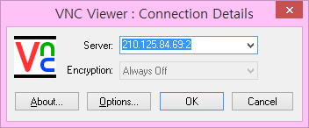
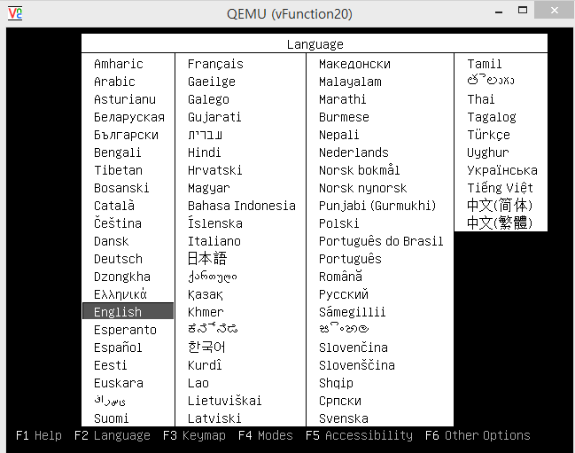
#7 - NUC: Making VM with KVM
-Install Ubuntu VM
IP address:vnc number
ex) 210.203.x.x:5

Slide 33
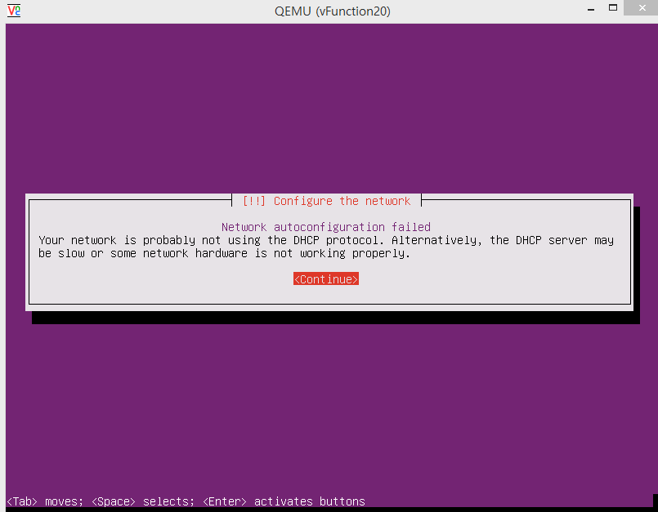

Slide 34
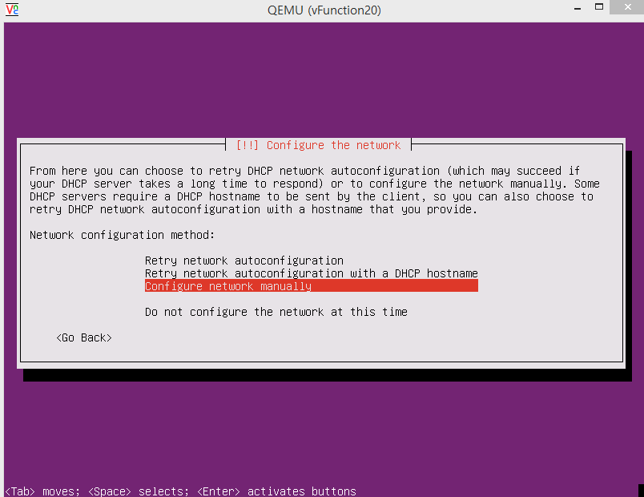

Slide 35
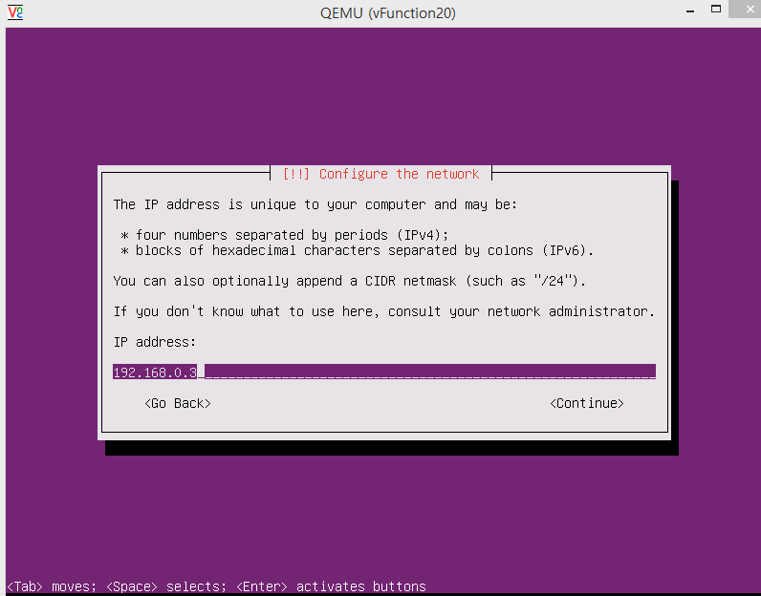
public address

Slide 36
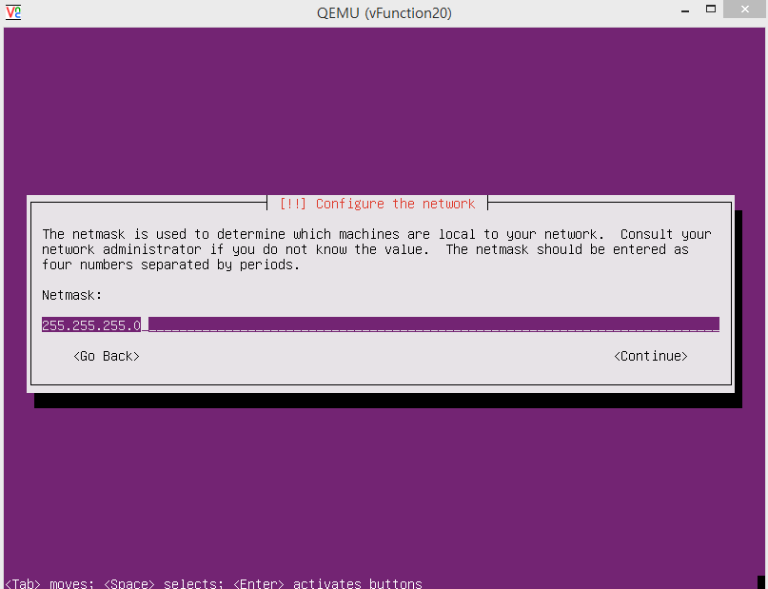

Slide 37
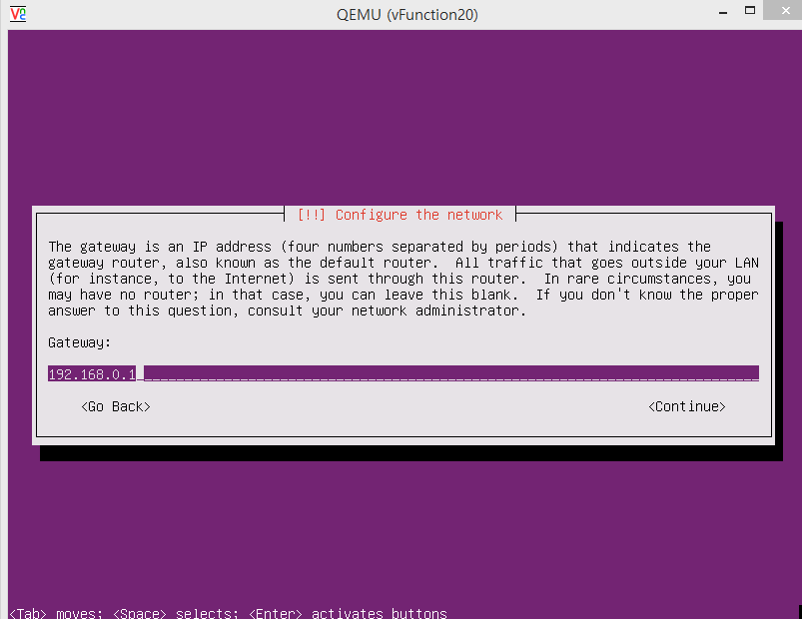
Gateway ip of your public network

Slide 38
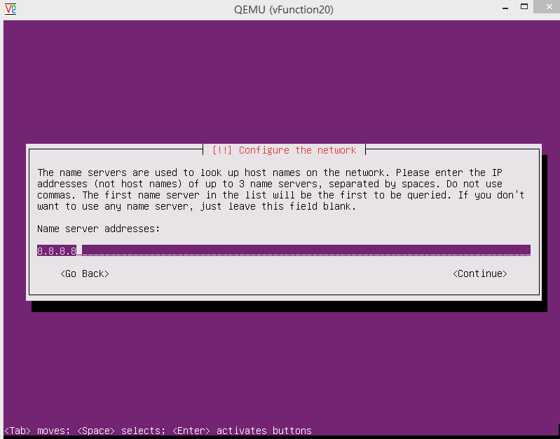
Google DNS server

Slide 39
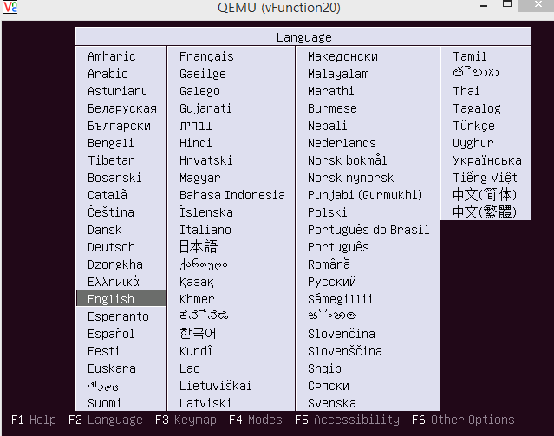
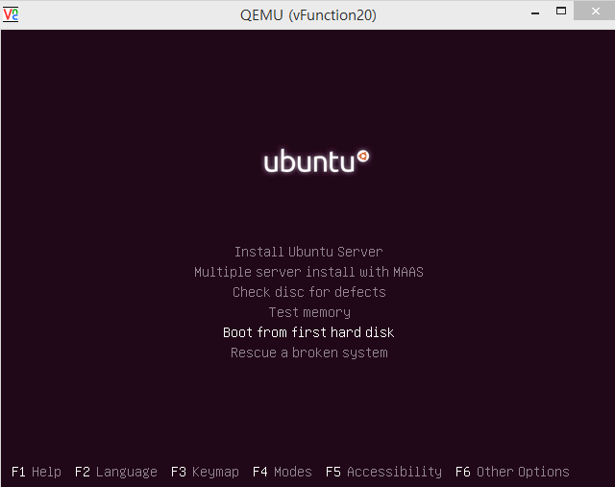
#7 - NUC: Making VM with KVM
- Eject Ubuntu install image
After installing Ubuntu Linux on the VM….
You need to eject Ubuntu install image before booting to the installed OS
$telnet localhost 3010
Trying 127.0.0.1...
Connected to localhost.Escape character is '^]'.
QEMU 0.11.0 monitor - type 'help' for more information
(qemu) eject ide1-cd0
Push Esc

Slide 40
#8 - NUC: Booting VM
- VM boot command
If you want boot VM again (mac should be different from others).
$sudo kvm -m [memory capacity] -name [name] -smp cpus=[#cpu],maxcpus= [#maxcpu] -device virtio-net-pci,netdev=net0,mac= [EE:EE:EE:EE:EE:EE] –netdev tap,id=net0,ifname= [tap_name],script=no -boot d [name].img -vnc : [#] -daemonize

Slide 41
#9 - OVS connects with KVM
- Check situation
VM
ip : 203.237.x.x
tap_name
br0
ip : 203.237.x.x
eth0
ip : 0

Slide 42
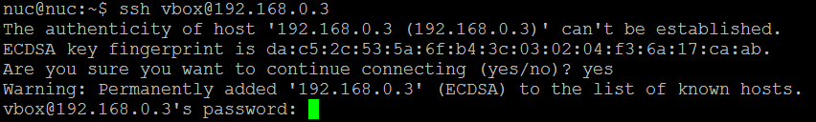
#10 - NUC: Installing ssh in VM
- Don’t forget to install ssh in VM
In VMs,
$sudo apt-get update
$sudo apt-get install ssh

Slide 43
Docker Container connected via OVS
- Goal of this section

Slide 44
#11 - Making a Docker Container
VM
Container
Tap0
ping test
br0
eth0

Slide 45
#11 - Making a Docker Container
- Docker installation
Docker installation.
$sudo wget -qO- https://get.docker.com/ | sh
$sudo systemctl start docker
$sudo adduser [Your_account] docker
(Session restart)
$sudo docker run hello-world
reference: http://docs.docker.com/linux/step_one/

Slide 46
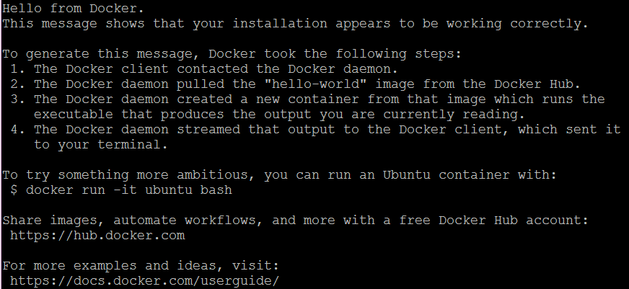
#11 - Making a Docker Container
- Docker installation

Slide 47
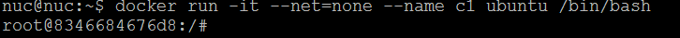
#11 - Making a Docker Container
- Make container
Run docker container.
$sudo docker run -it --net=none --name [container_name] ubuntu /bin/bash
I want to make interface that has 203.237.x.x IP address.
※ctrl + p, q → detach docker container
※docker attach [container_name] → get into docker container console

Slide 48
#12 - Connect Docker Container
- Connect with OVS bridge
VM
Container
Tap0
ping test
br0
eth0

Slide 49
#12 - Connect docker Container
- Connect with OVS bridge
Install OVS-docker utility in host machine. (Not in inside of Docker container.)
$sudo OVS-docker add-port br0 eth0 [containerName] --ipaddress=[IP_address]/24 --gateway=[Gateway_address]
$sudo docker attach [containerName]
#apt-get update
#apt-get install net-tools
#apt-get install iputils-ping

Slide 50
#13 – Keep Docker network configuration
- /etc/rc.local
Modify /etc/rc.local
$sudo vi /etc/rc.local
docker start [container_name]
OVS-docker del-port br0 eth0 [containerName]
OVS-docker add-port br0 eth0 [containerName] --ipaddress=[IP_address/24] --gateway=[Gateway_address]
Whenever NUC is rebooted,
network configuration of Docker container is initialized
by executing commands in rc.local

Slide 51
#14 – Check connectivity: VM & Container
VM
Container
Tap0
ping test
br0
eth0

Slide 52


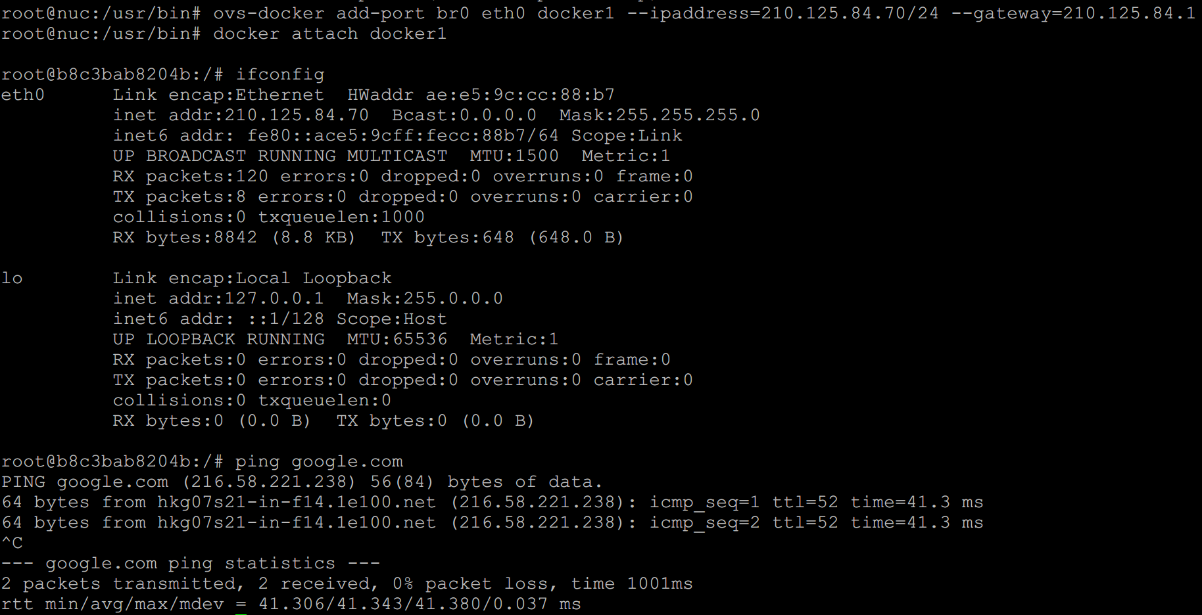
#14 - Check connectivity: VM & Container
-Check connectivity with ping command

Slide 53
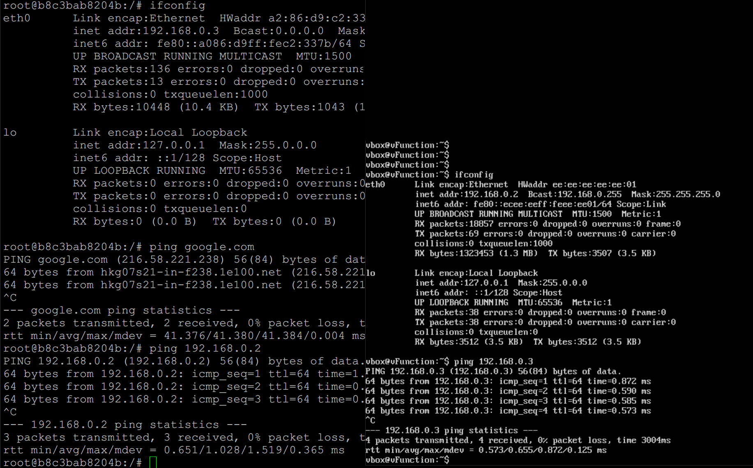
#14 - Check connectivity: VM & Container
-Check connectivity with ping command
Docker container
KVM VM

Slide 54
Box Lab: Final Goal (Recap)
VM

Slide 55
Lab Review

Slide 56
Lab Summary
With Box Lab, you have experimented
How to install and configure Linux OS into Box (i.e., computer).
How to install and configure OVS (Open vSwitch) virtual switch inside a Linux Box and configure it.
How to create VMs and Docker containers inside a Linux Box and then inter-connect each of them together and to the Internet.

Slide 57
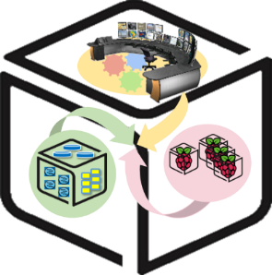
Thank You for Your Attention
Any Questions?
mini@smartx.kr

